Slide 1
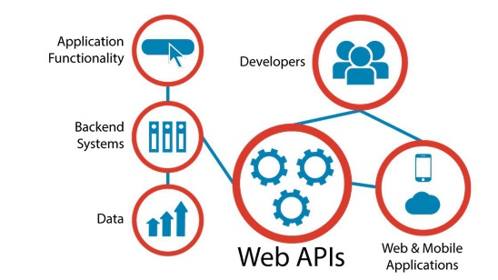
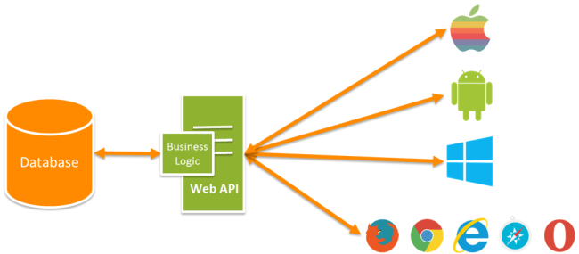


WEB APIs TRAINING
I. Purpose
Provide basic programming to newcomers
Quality up application jobs by sharing extended knowledge & typical notes
Standardize programming with all components (security, middleware, extension method, data provider,…)
II. Training result
Training date:
10 ~ 20.Sep
Q’ty class: 2 (19.5h/class)
Q’ty trainee: 12
Training content:
Level 1: basic
Level 2: Advance
Training method: online & offline
General assessment after training:
Useful course!
Easy to learn and make immediately improve the job!

